Slide 1
Annual Report 2015/16

Slide 2
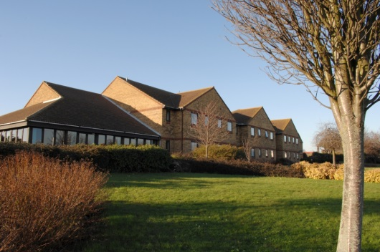
Tendring Careline and our Service Users
Corporate Goal - Support older people to live independently in their own homes.
Mission Statement - “To provide a professional installation, call-handling and response service, enabling Service Users to maintain independent living, with dignity and peace of mind.”
Tendring Careline is a community alarm service offered 24 hours a day, 365 days-a-year and based in Clacton-on-Sea. It provides installation and monitoring of alarms, and response to Service Users who live in the Tendring area. We also offer monitoring services to a number of other landlords locally, and overnight and weekend services across central Essex. Around 3,000 Service Users in Council owned homes, in sheltered accommodation and private dwellings currently benefit from the service in Tendring with an age range of 4 Years – 101 Years!
In June 2010 we moved into our new, purpose built Control Centre, in Barnes House. The new Centre was equipped with the latest technology, which has allowed us to improve our monitoring service and we keep abreast of other emergent technologies so that we can keep people living independently in their own homes for longer. All equipment is supplied to Service Users on a needs assessment basis. We take great pride in the knowledge that we have the ability to cater for the diversity that we find across the district.
We also operate 10 Sheltered Housing Schemes where staff are on hand, or on call 24-hours-a-day. Residents also have use of the same equipment as those living in their own homes and calls are either handled on-site by staff during normal working hours, or via our Control Centre out of hours.
Greenfields, Frinton

Slide 3
Our performance
In order to illustrate how we are performing, we measure a range of indicators. Many of these are industry standard as set by the Telecare Services Association and allow us to compare our performance with similar service providers. They also allow us to track progress.
We have broken the results down by each area that is being measured. Each indicator describes what area it is measuring, the target and our performance against that target.
Installations
Indicator | Target | Our Performance
Urgent Installations carried out within 3 working days | 90% | 100%
Remaining urgent installations carried out within 6 working days | 100% | 100%
Non-urgent installations carried out within 16 days | 90% | 99%
Remaining non-urgent installations carried out within 21 days | 100% | 100%
Repairs
Indicator | Target | Our Performance
Critical repairs carried out within 2 days | 90% | 100%
Remaining critical repairs carried out within 4 days | 100% | 100%
Non-critical repairs carried out within 11 working days | 90% | 99.58%
Remaining non-critical repairs carried out within 16 working days | 100% | 100%
Call Handling
Indicator | Target | Our Performance
Calls answered within 1 minute | 98.50% | 98.81%
Calls answered within 3 minutes | 99% | 99.92%

Slide 4
Our performance cont…
Responding to a call where a Mobile Support Officer is required to attend
Indicator | Target | Our Performance
Attending an address within 45 minutes of a call | 90% | 97.4%
Attending remaining addresses within 60 minutes | 100% | 100%
Complaint handling
Indicator | Target | Our Performance
Number of complaints received (Formal Written Complaints) |  | 2
Acknowledgement of complaint sent to complainant within 5 working days | 100% | 100%
Response to complaint sent to complainant within 20 days | 100% | 100%
Service User satisfaction
Indicator | Target | Service Quality | Speed of Response | Staff helpful | Good Value | Overall
Satisfaction with installation service | 90% | 100% | 100% | 100% | 100% | 100%
Satisfaction with monitoring service | 90% | 98% | 98.9% | 99.4% | 98.3% | 98.65%
Satisfaction with response service | 90% | 100% | 100% | 100% | 100% | 100%
Consumer involvement
To ensure we keep abreast of our Service Users’ needs, both current and future, we meet with the Tendring District Council Tenants Panel and Sheltered Housing Panel on a bi-monthly basis. This gives us a formal setting for discussions, that can range from technological advances and current performance statistics, to more personal observations such as the dress and demeanour of the Careline team. Such meetings are vital and give us an insight into the public perception of our brand and inform how we develop our service.

Slide 5
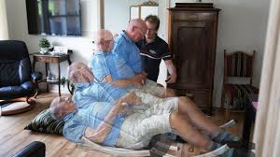
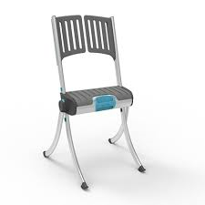
2015/16 Highlights
During 2015 we started the conversation with our Service Users about the possibility of introducing a ‘Lifting’ Service. We explained, that if they fell but were uninjured, one of our Mobile Support Team could arrive quickly with the correct equipment, and after assessing the situation, lift them off the floor if it was appropriate to do so. Our Service Users were very excited about this service development and so the idea was costed out and taken to Council for approval.
In February 2016 it was agreed that Careline should add this service to its’ portfolio, and furthermore that Tendring District Council will fund the service for 3 years for Tendring residents. The service should be available towards the end of summer 2016.
A number of the Careline Operators started a Level 2 Certificate in Supporting Users of Technology-enabled Care Services. This qualification will provide a valuable accreditation of skills and knowledge and contribute to the knowledge and understanding of the team as professionals. We are pleased to say that the first students are completing this qualification and we look forward to further team members undertaking this learning.
Raizer portable lifting equipment
Our agreement with Carecall (the equivalent of our Careline but across central Essex) to provide services out-of-hours and at weekends, has been extended to include the monitoring of their lone workers and also first point of contact for hospital incidents. These extensions are testament to the quality service that our team in Tendring provide.
Lastly, in August, the Telecare Services Association confirmed that we had retained our Platinum Accreditation in all eight standards that we are judged against. We are proud of our team and the service we provide to our Service Users.

Slide 6
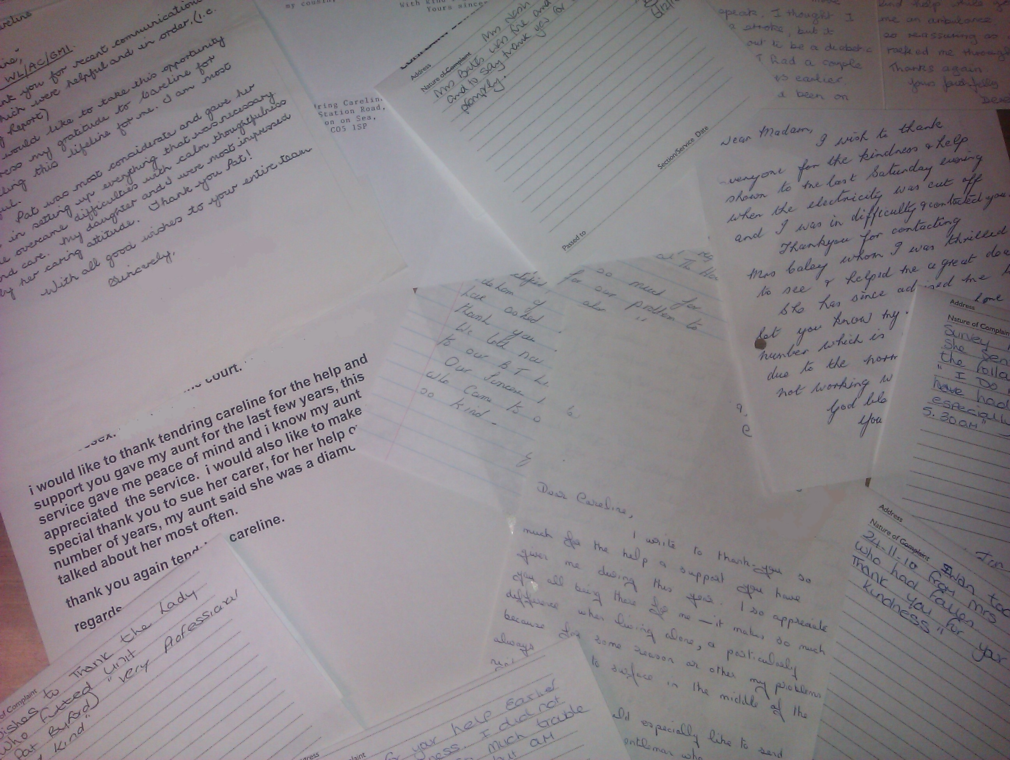
What our Service Users say…
I would not be without this service, it is definitely a life line, thank you – Mrs J Moorecroft (September 2015)
When help was needed the staff were very helpful. They kept in contact with me and gave me advice until the paramedics arrived. Thank you all – Mrs D Smith (July 2015)
Thank you for the efficient but also kindly and patient way of handling in my immediate moment of pain. – Mrs J Samuels (May 2015)
I have always found Careline staff very helpful and willing to go the extra mile when the situation requires it. I would never be without it – Mrs T. Howard (May 2015)
Now I am living on my own I find the Careline really great. I know there is always somebody to help me. I find them always friendly and of course efficient – Mrs B Davis (September 2015)
The response has been very good when the alarms have gone off. This makes us feel secure in our old age - Mr & Mrs Plant (May 2015)
I think the service you provide is first class in every way. Long may you carry on – Mr J Purday (November 2015)

Slide 7
The Future
It looks set to be another busy year. During 2016 we will complete the implementation of the ‘Lifting’ service and will soon be out-and-about in the district picking people up, who have fallen. Look out for our new ‘Lifting’ car.
We also have plans to create a training package that will be tailored especially for the Tendring Careline team. This digital training will allow staff to keep up to date with new enhancements and refresher training at any time day or night.
Whilst we are looking at technology, we shall also be introducing a scripting tool into the Control Centre. We deal with such a wide variety of demanding calls and enquiries, but this new tool will prompt our Operators to ask the right questions and solicit all the important information from our Service Users.
We need to upgrade the Careline computer system as well. This will allow us to complete forms online instead of manually entering the data on the computer system, when the hand written records are brought back to the Control Centre. This will save time for the Mobile team who can then spend more time helping Service Users.
Lastly, we are working with colleagues at Essex County Council to improve the equipment ordering system. This digital solution should be online sometime during the summer and will aid stock taking, the flow of information between us, and should increase the number of products that Tendring Careline is able to offer. Pop down to our showroom in Pier Avenue, Clacton for a chat about this.
Clacton promenade

Slide 8
Tendring Careline
Barnes House
92 Pier Avenue
Clacton-on-Sea
Essex
CO15 1NJ
Telephone: 01255 222022
Minicom: 01255 422470
Fax: 01255 220380
Email: careline@tendringdc.gov.uk
Web: www.tendringdc.gov.uk/careline
@Tend_Careline

